Slide 1
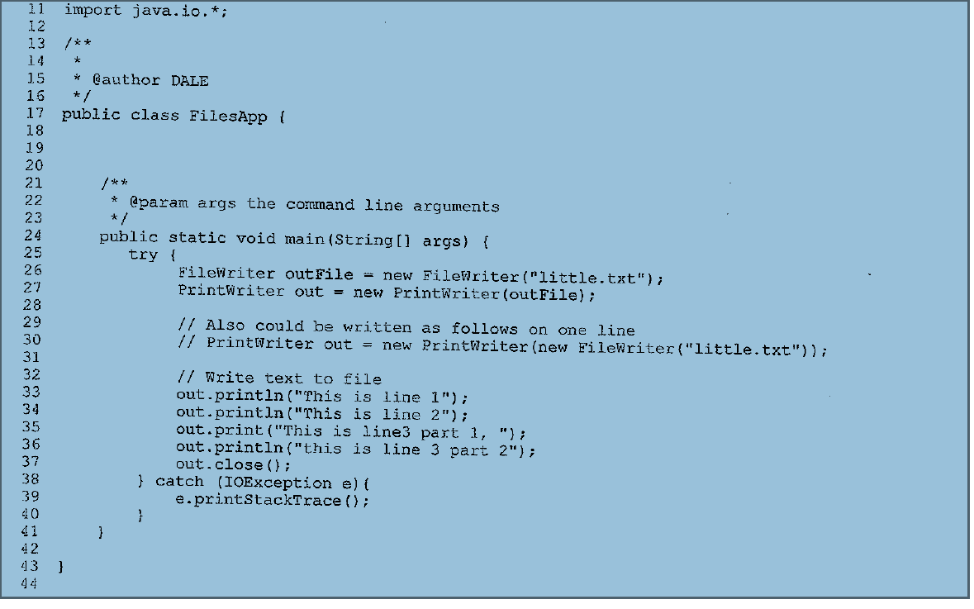


Slide 2
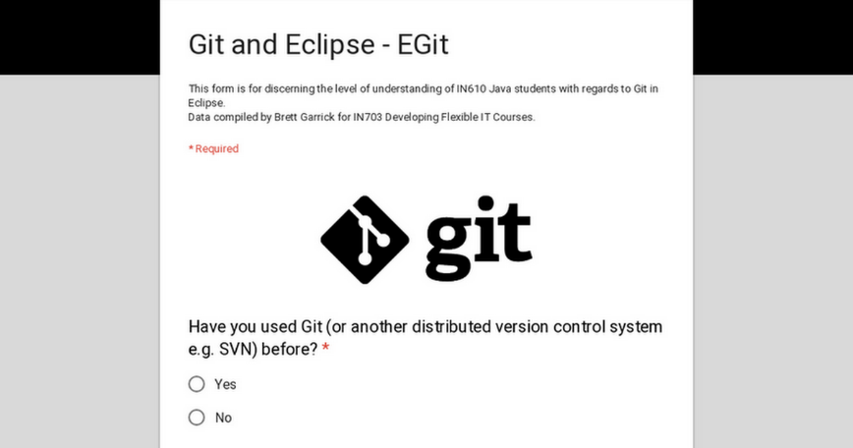
Egit- Git and Eclipse
Here is the google forms link for the class to fill out the Training Needs Analysis.
https://forms.gle/1TMuDMKh8FRHrKbY7
 | This form is for discerning the level of understanding of IN610 Java students with regards to Git in Eclipse.
 | Git and Eclipse - EGit goo.gl This form is for discerning the level of understanding of IN610 Java students with regards to Git in Eclipse. Data compiled by Brett Garrick for IN703 Developing Flexible IT Courses.

